Slide 1

MSUS Workshop
Dr. Jonathan Emery
Apr. 19, 2019
https://github.com/emeryjdk/MSE-OverleafTutorial

Slide 2
When to ?
If you want something to look really nice or professional.
If you are writing a long document with lots of references/cross-references.
If you are writing something in the field of physics/mathematics (or chemistry).
If you want a more satisfying writing experience.
If you need to be precise with regards to typesetting (equations, symbols, accents, etc.)
If you want to do advanced typesetting that might require coding (more later, maybe).
If you want something free that will forever be free.
If you want to make your MAT_SCI 332/406 laboratory instructor happy.
If you need to finish something quickly.
If you are doing something simple.
If you need to co-edit a document with non-users or novices*.
If presentation or precise typesetting isn’t terribly important.
If you PI doesn’t allow it.
If you really don’t care about impressing your MAT_SCI 332/406 laboratory instructor.
When not to ? (e.g. use Word)

Slide 3
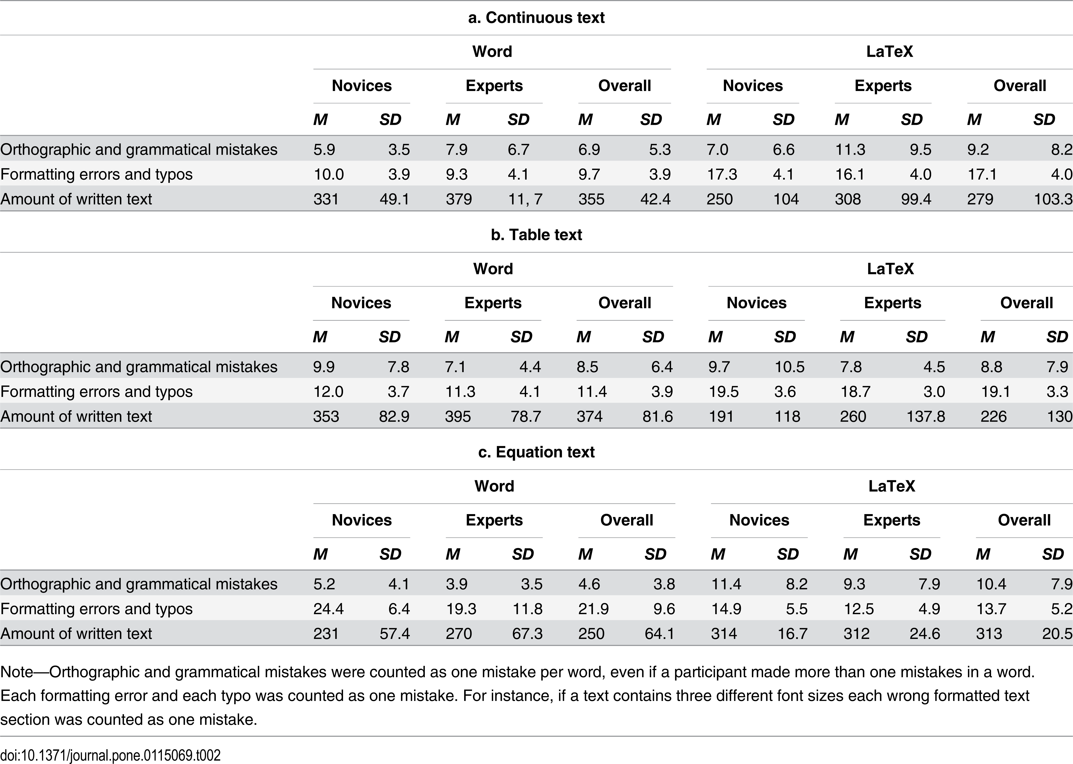
A Study…

Slide 4
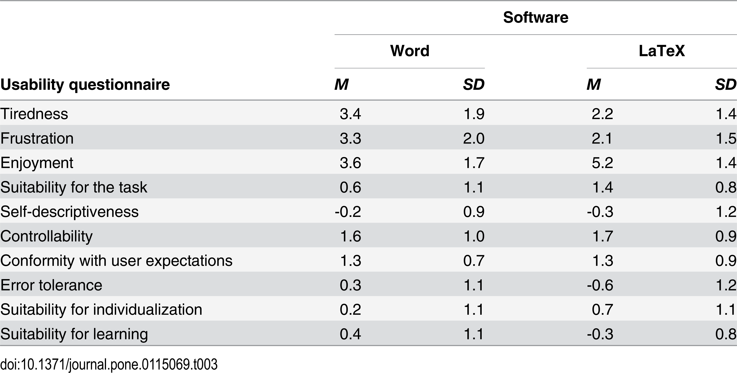
A Study… Questionnaire ISO 9241/10
Negative is “less”, zero is neutral, positive “more”

Slide 5
When to Use
Effort
Word: Natural Sciences
Word: Social Sciences
LaTeX
Complexity
Letters/P-sets
Essays/Reports
Manuscripts
Theses
Books*
Course Documents
+notes +equations +symbols
+tables +graphics
+sections +bibliographies
+cross-referencing +contents
+indexing
+custom environments
+databases
+version control +scripting (native or external) +rich media**
Lines may translate/morph depending on user skill level and precise needs. *I’d actually suggest R and bookdown for self-publication of books.

Slide 6
Outline
Let’s make an article!
Hello World!
Text formatting
The preamble
Document class
Packages
Global formatting
The document
Create your title/title page.
Create your abstract
Sections, subsections, subsubsections.
Figures!,Tables! Equations! Bibliography!
Organization
Table of contents
Cross-referencing, hyperlinking.
The Fancy:
Making a really nice CV (next!).
Exam-class documents
media9 package: videos, audio, and 3D figures
Beamer
Don’t kill yourself – in PowerPoint or LyX.
Making graphics? (TiKZ, Asymptote, Mathematica, Inkscape)
Conditionals
Custom commands
Custom environments
Fancy chemistry packages/drawing
Recipe book ()
… anything you want.

Slide 7
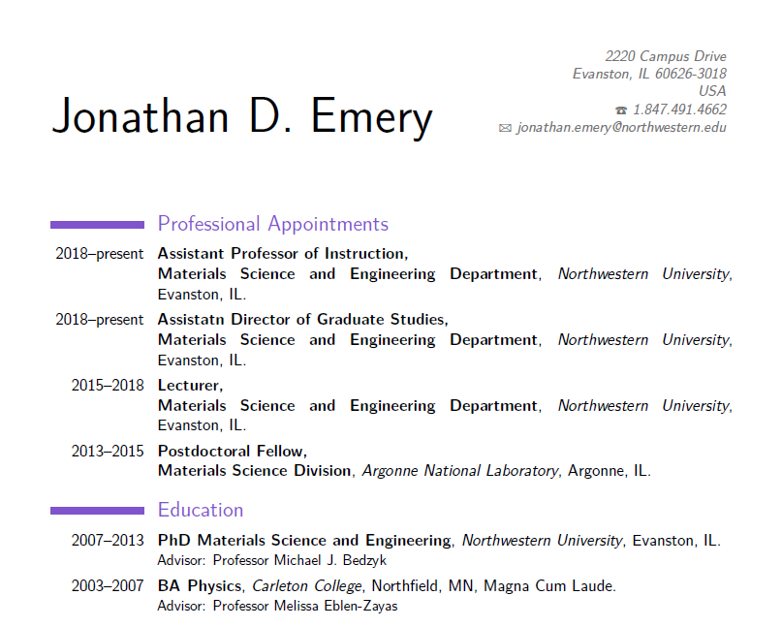
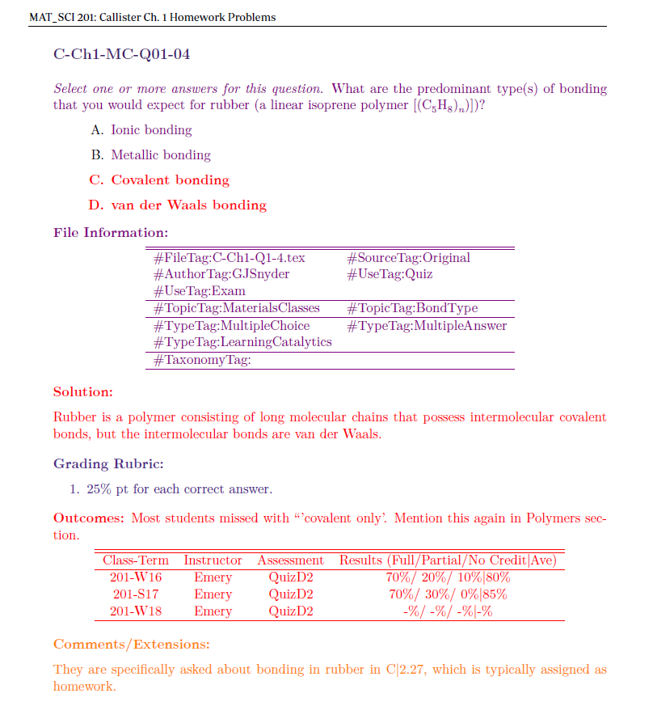
Gallery

Slide 8
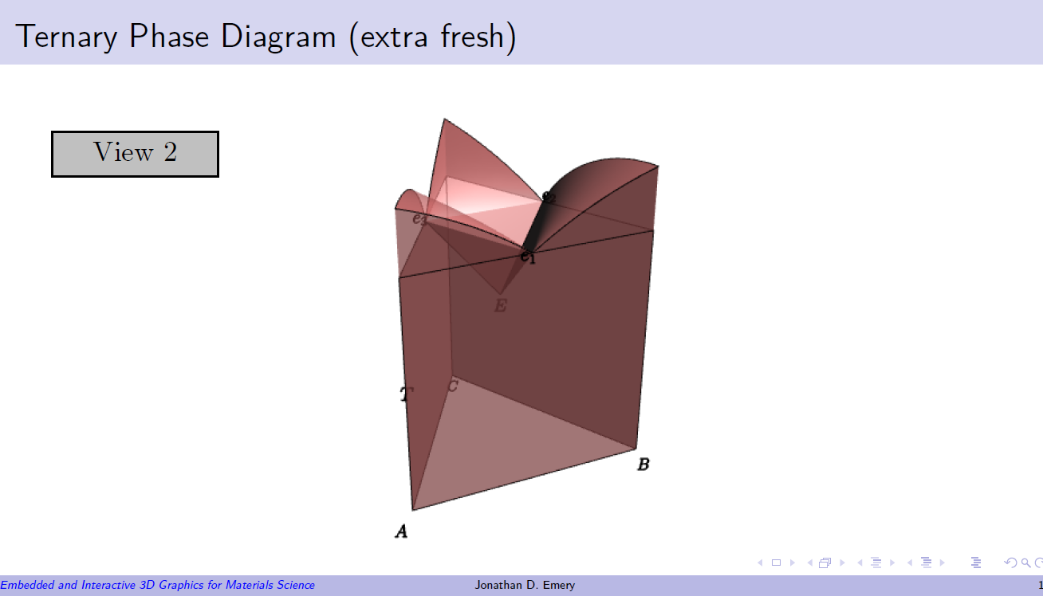
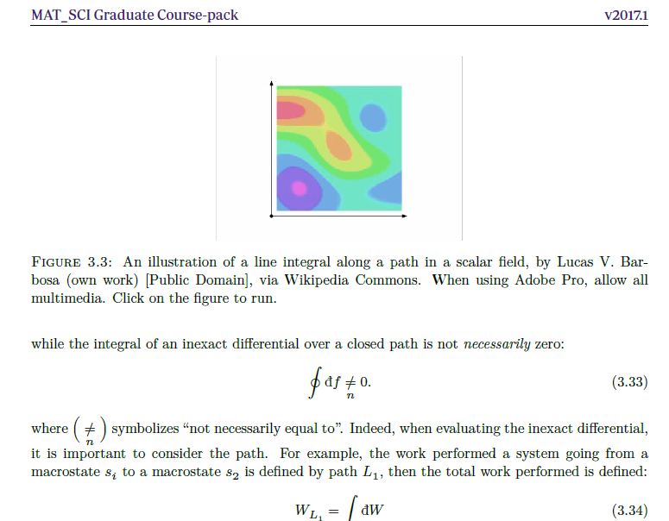
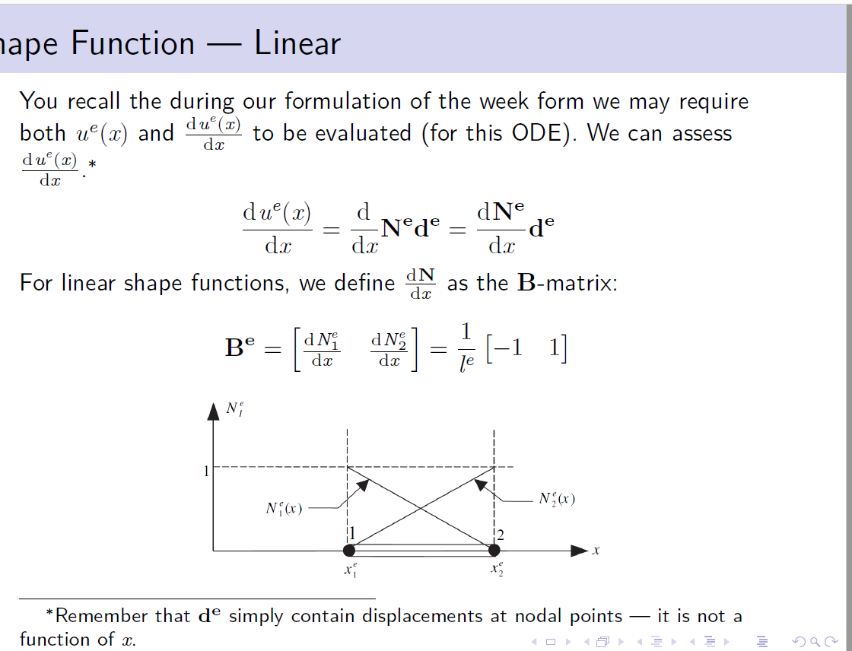
Gallery

